Slide 1
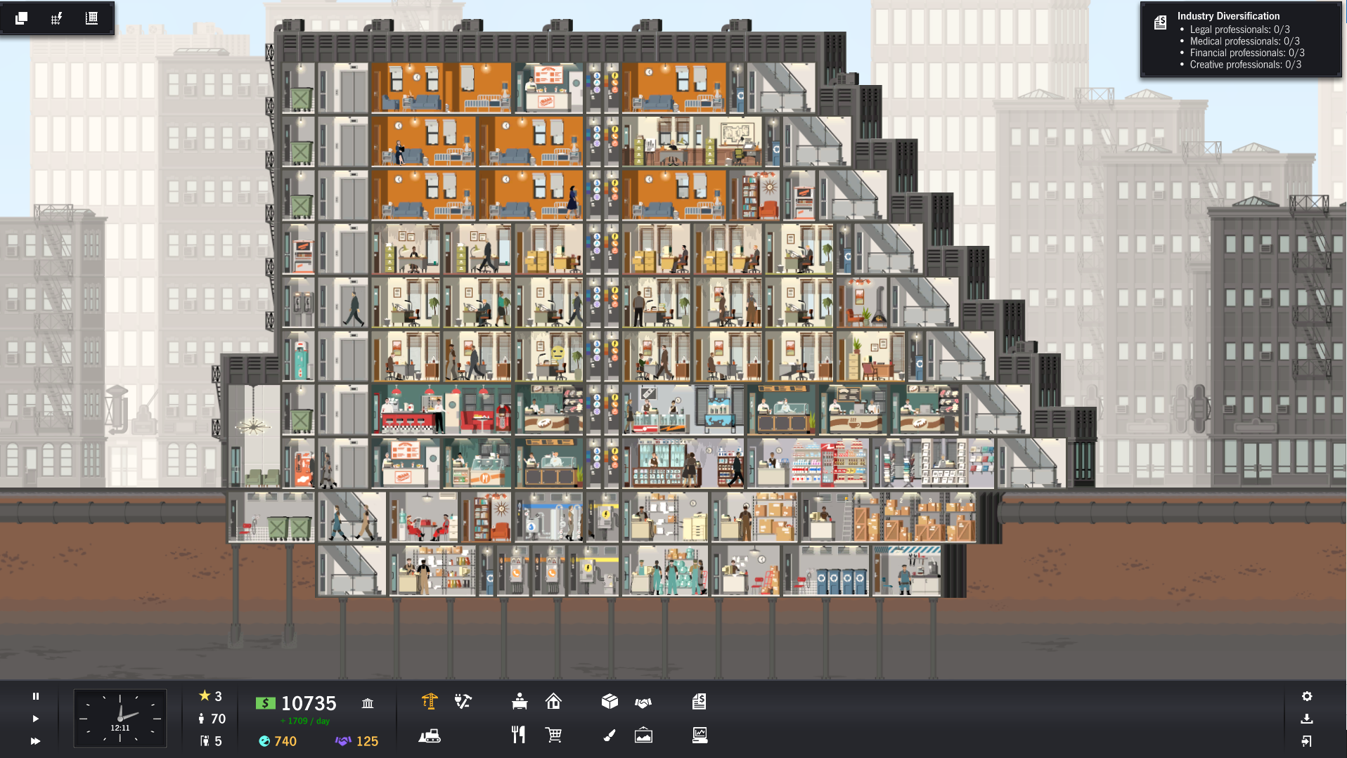
Specs:
7 apartments (6 tiny studio and 1 small one bedroom);
9 restaurants (8 small and 1 medium);
19 offices;
4 stores;
3 common areas;
8 stories;
2 stories lobby;
Elevator in all upper levels,
Emergency stare case;
Water and electricity for all levels;
Revenue +500/day;
Al least 4 recycling bins;
Apartment building in the upper floors;
Stores in the lower floors;
Version 1

Slide 2
Specifications for Version 1:
Specs:
7 apartments (6 tiny studio and 1 small one bedroom);
9 restaurants (8 small and 1 medium);
19 offices;
4 stores;
3 common areas;
8 stories;
2 stories lobby;
Elevator in all upper levels,
Emergency stare case;
Water and electricity for all levels;
Revenue +500/day;
Al least 4 recycling bins;
Apartment building in the upper floors;
Stores in the lower floors;
This version of the building to be completed by students A to M
Your building should match the design of the given building. If you happen to have empty spaces in the building fill them with such building amenities as vending machines, pay phones, etc.

